Slide 1
Raspberry_Start
3120102146 Xianlong Ge
2015.04.01

Slide 2
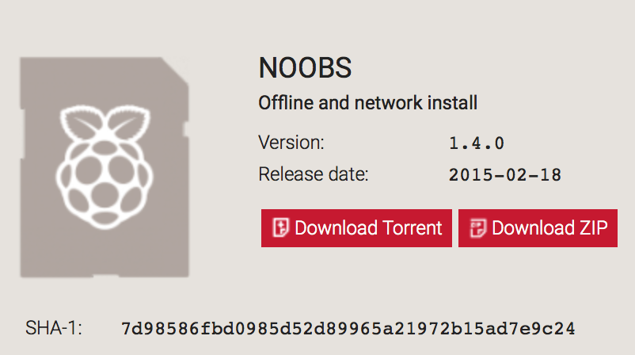

Download img
website www.raspberrypi.org
unzip

Slide 3
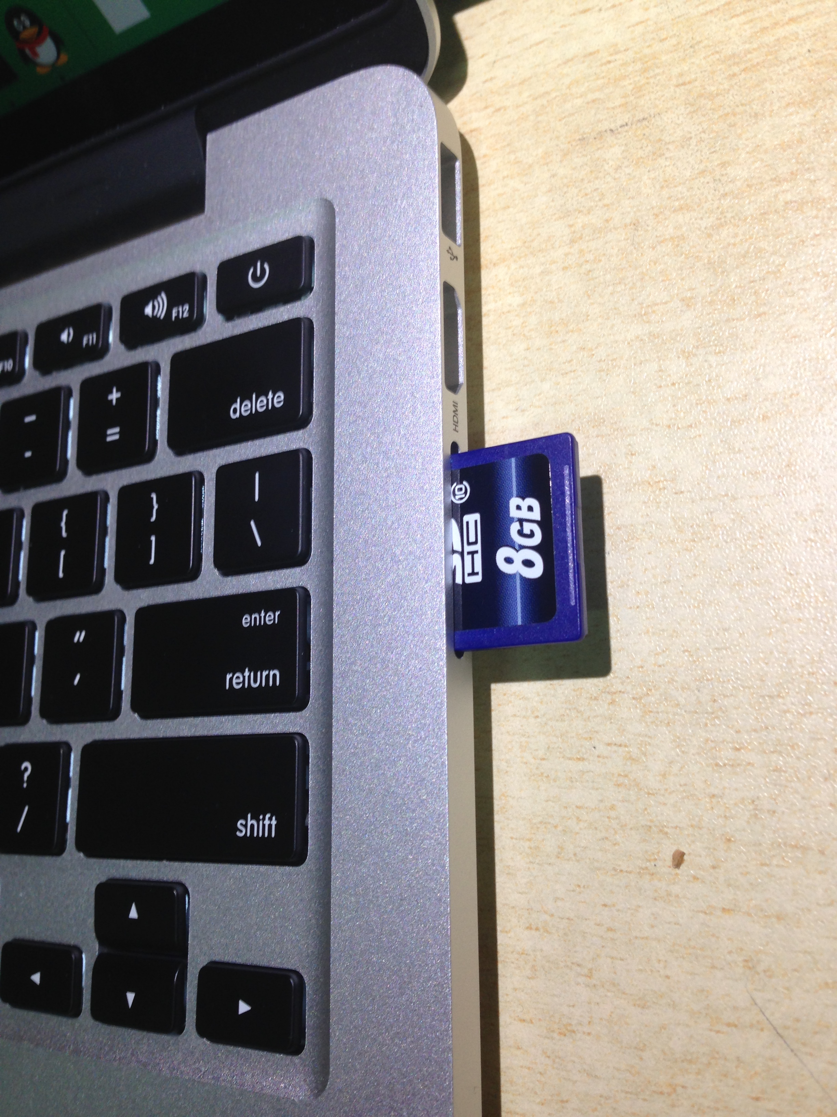

SD

Slide 4
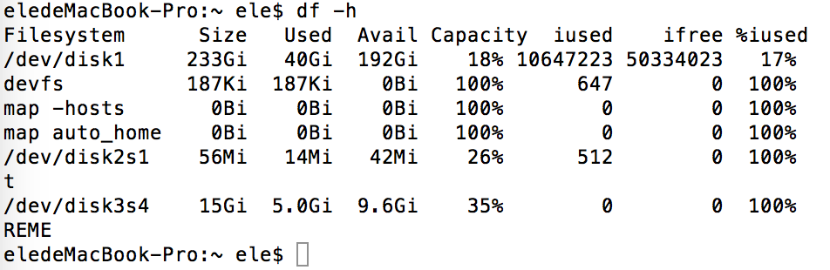
Write SD
$df -h
$sudo diskutil unmount /dev/disk2s1
$sudo bs=1m if=2015-…wheezy.img of/dev/rdisk2

Slide 5
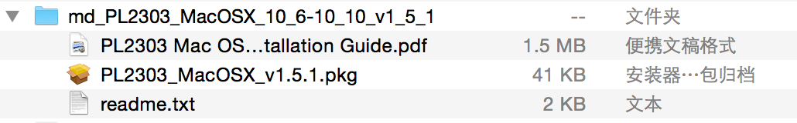
Serial Port Diver
website http://www.prolific.com.tw/US/ShowProduct.aspx?p_id=229&pcid=41

Slide 6
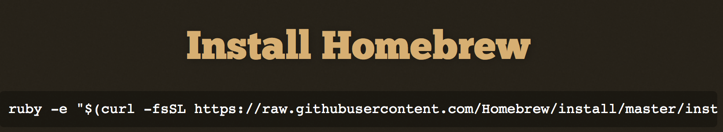
Install Mac Port or brew
MacPort www.macports.org/install.php
brew http://brew.sh/

Slide 7
Install miniom
MacPort $sudo port install minicom
brew $brew install minicom

Slide 8
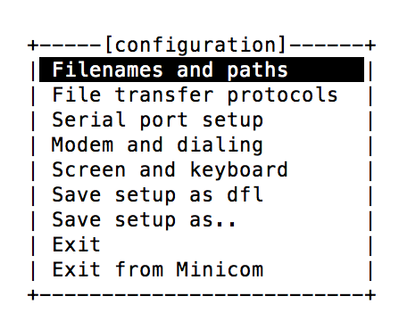
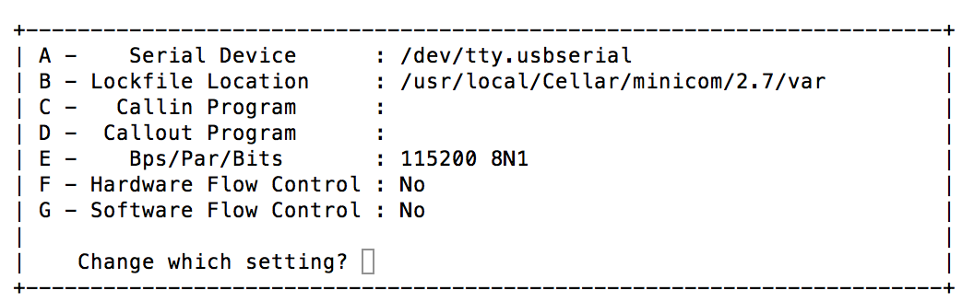
Minicon
$minicom -s
Serial port setup
Save setup as dfl

Slide 9
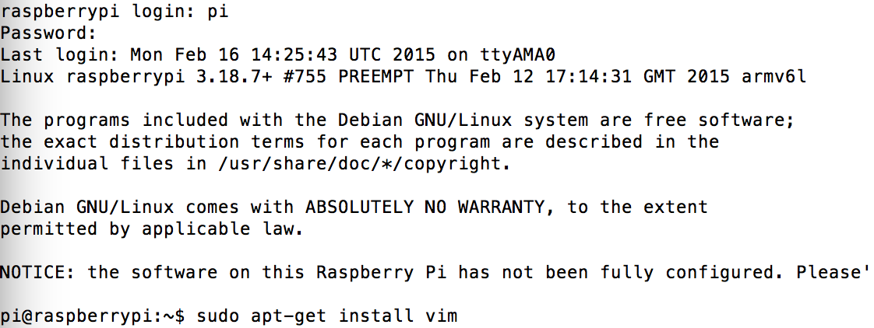
Login
$minicom
ID = pi Password = rasberry

Slide 10
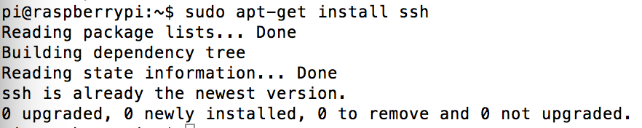
Install ssh
$sudo apt-get install ssh

Slide 11
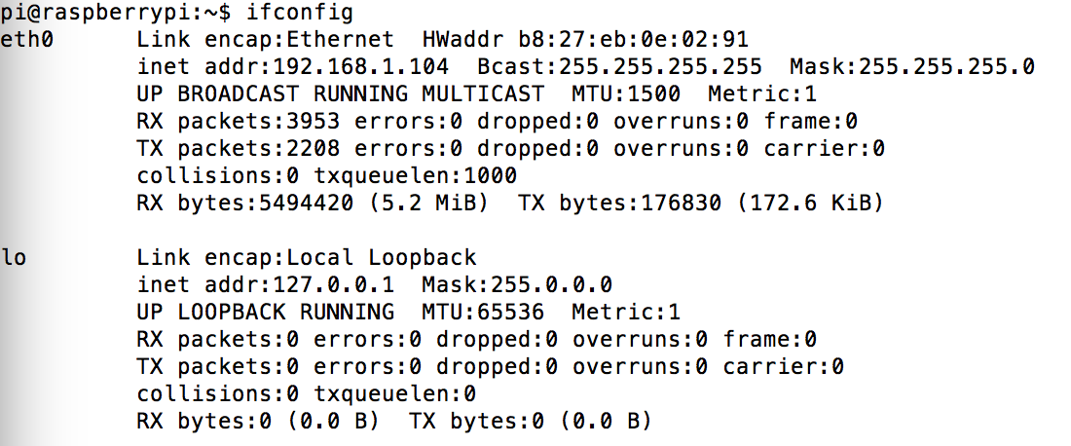
IP ifconfig
$ifconfig

Slide 12
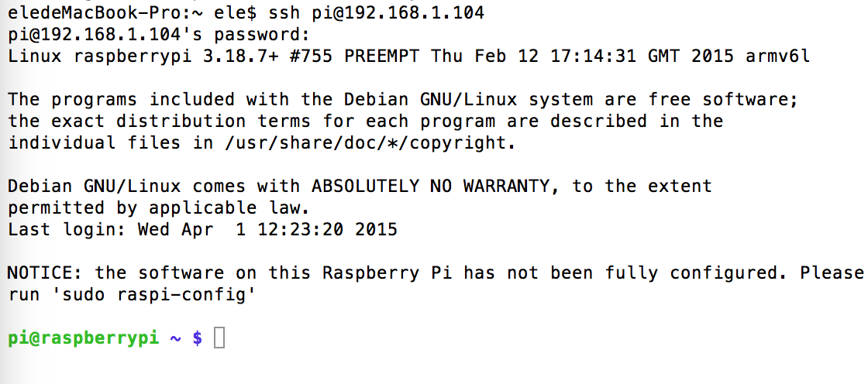
Macbook ssh
$ssh pi@192.168.1.104
password rasberry

Slide 13
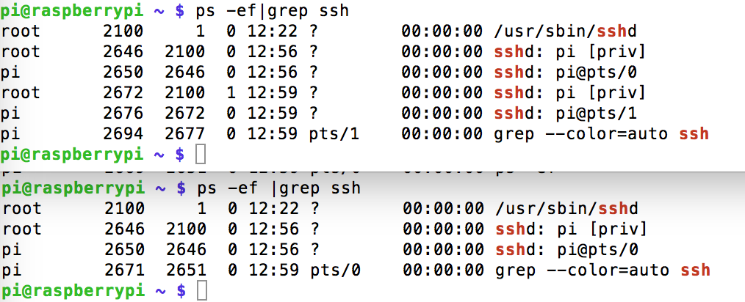
Two ssh

Slide 14
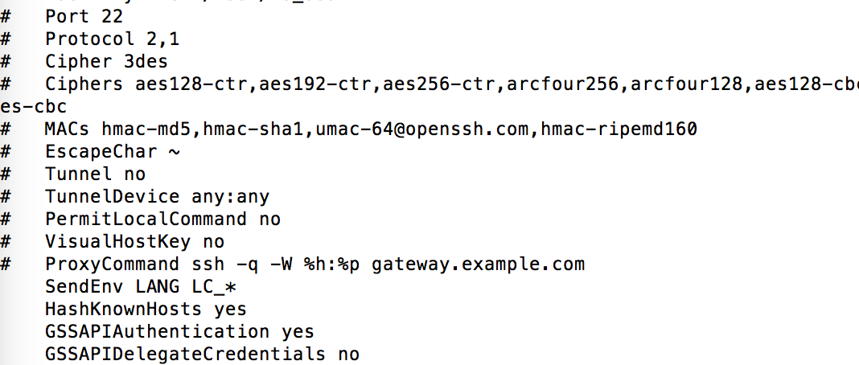
ssh_config
$vim /etc/ssh/ssh_config

